Slide 1
What Differentiates Top Regions from Other Regions in the Field of Biotechnology? An Empirical Study of 101 Biotech Regions
Cathy Lecocq & Bart Van Looy
MSI (FEB) & INCENTIM/Ecoom
VIVES – STORE Faculty of Business and Economics, KU Leuven
Sevilla
14.04.2014

Slide 2
Outline
Field of Biotech
Research question
Data
Analyses
Conclusions

Slide 3
Intro
Innovative activities, especially in knowledge-intensive industries such as biotechnology display a tendency to cluster geographically.
e.g. San Francisco Bay Area, San Diego and Boston in the US.
There is a general consensus that well developed biotech clusters are characterized by:
world-class scientific research,
high levels of entrepreneurial activity (both academic spin-offs and industrial spin-offs),
high labor mobility and dense social networks, and
the presence of the dedicated supporting infrastructure and venture capital
Research on biotech clusters is mostly based on case studies,
Only few systematic quantitative analyses

Slide 4
The Field of Modern Biotechnology
Science-base technology building on some important discoveries by academic researchers in the field of molecular biology
1953: double helix structure of DNA (Univ of Cambridge, UK);
1973: recombinant DNA technique (Stanford Univ, Univ of California)
From the 2nd half of the 1970’s onwards, new dedicated biotech firms were set-up to explore and commercialise the results of scientific research.
Greater Boston area: > 50 spin-offs from MIT; > 50 start-ups by academic inventors
By the late 1989s, large established firms entered the field by setting up strategic alliances with and/or acquiring small firms.
Region of Basel: strong presence of pharmaceutical industry (Novartis, La Roche)
Further technology advances rely to an important extent on interorganisational collaborations between organisations with complementary resources.

Slide 5
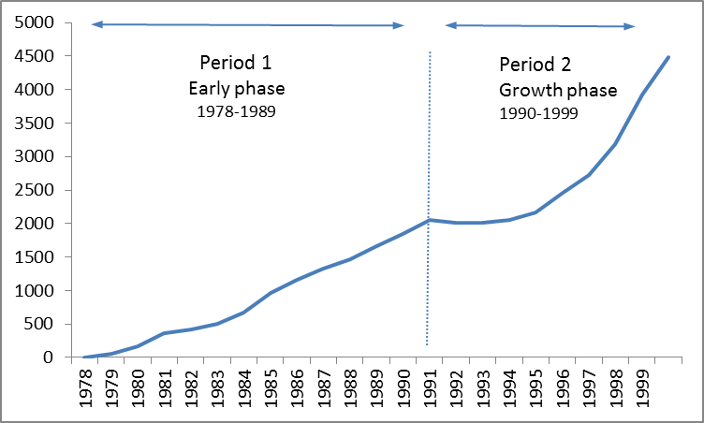
The Field of Modern Biotechnology
EPO Patents 1978-1999, worldwide
Early stage of the biotech industry life cycle (period 1)
The technology is still new, technical and market uncertainty prevails.
Characterized by the creation of the first dedicated biotech firms.

Slide 6
The Field of Modern Biotechnology
EPO Patents 1978-1999, worldwide
Growth stage of the biotech industry life cycle (period 2)
Technologies start to demonstrate potential commercial impact, but important leaps in the technology performance still have to be realized.
Large pharmaceutical firms start to enter the field.

Slide 7
Case study research
Central and active role of universities and knowledge generating institutes in the creation of biotech clusters in the region of Boston (Breznitz, O‘Shea, & Allen, 2008) and the San Francisco Bay area (Chiarone & Chiesa, 2006).
Pivotal role of private firms in the development of biotech activities in the region of Basel, Switzerland (Houlton, 2003) as well as in Japan (Bartholomew, 1997).
Different pathways of regional cluster formation
or life cycle dynamics?

Slide 8
Evolution of biotech patenting
EPO Patents 1978-1999, worldwide
RQ: Can regions develop into leading biotech regions by relying on a distributed texture (public knowledge institutes and private firms)
or does the presence and/or emergence of an anchor tenant firm (Agrawal & Cockburn, 2003) becomes a prerequisite to become a ‘leading’ region?

Slide 9
Research question
Can regions develop into leading biotech regions
by relying on a distributed texture
(public knowledge institutes and private firms)
or does the presence and/or emergence of
an anchor tenant firm becomes a prerequisite
during the growth phase of the biotech industry?

Slide 10
Industrial texture
By their nature and core ‘raison d’être’, private firms are best placed to identify market needs, translate technological opportunities into prototypes and commercial products, and bring these new products on the market.
A large firm might be a better anchor of economic success in emerging industries than an equivalent number of small firms because of their scale, extensive industry expertise and access to financial resources.
H1a: Regions in which technology development activities are to a larger extent driven by firms, are more likely to become a leading biotech region (during the growth phase).
H1b: Regions with higher levels of concentration of technology development activities within an anchor tenant firm are more likely to become a leading biotech region (during the growth phase).

Slide 11
Entrepreneurial-oriented knowledge institutes
As the field of biotech further develops, scientific knowledge is spreading on a global scale. The diffusion of knowledge is further enhanced by numerous collaborations between public knowledge institutes and private firms.
Therefore, the presence of a strong local science-base and entrepreneurial-oriented knowledge institutes in the region may become less important in latter stages of the technology life cycle.
H2a: The science-intensity of a region, measured by the number of publications per population, is no longer instrumental for becoming a leading biotech region (during the growth phase).
H2b: Likewise, the entrepreneurial orientation of scientific actors, measured by their involvement in technology, is no longer instrumental for becoming a leading biotech region (during the growth phase).

Slide 12
Biotech patent and publication data
Dataset of biotech patents (1978-1999) and publications (1992-2001)
Biotechnology domain study by Expertise Centre for R&D Monitoring
Patents as indicators of:
Technological performance of regions and firms
Composition of the texture of regions in terms of presence of knowledge generating institutes (universities and research centres) and private firms
Co-Patents as indicator of R&D collaboration
Publications as indicator of the science-intensity of regions
Comparable data covering regions at worldwide scale,
over longer time periods and in specific technology fields

Slide 13
Preparing the data
“Regionalisation of patent data” Lecocq et al.
Allocation of all patents and publications to their respective regions based on the address information of applicants (patents) and authors (publications)
“Sector allocation” Du Plessis et al.
Identification of the type of actor (private firms, public universities and research centres, research hospitals and/or persons) by which a patent has been applied.
“Name harmonizing” Magerman et al.
Identification of the firm and/or other actor with the largest number of patents in the region is identified.
Patent Statistics at Eurostat: Methods for
Regionalisation, Sector Allocation and Name Harmonisation.
2011 Eurostat Methodologies and Working Papers.

Slide 14
Indicators
Typology of firms
Variable | Description
New Dedicated Biotech Firms (NDBF) | Firm primarily active in the field of biotechnology and established after 1974.
Established Firm (EF) | Firm primarily active in other fields than biotechnology (e.g. pharmaceutical, chemical, food and other industries) and established before 1974.
Other Firm | Firm active in the field of biotechnology but not as a product or research company (e.g. regional technology transfer offices, venture capitalist, regional industrial promotion agency)
Texture characteristics
Variable | Description
Number of firms | Number of companies active in biotech patent applications in the region.
Company concentration index | Ratio of the number of biotech patents of the leading firm in the region and the total number of company biotech patents in the region.
Science-intensity of the region | Number of biotech publications in the region per 1000 population.
Entrepreneurial orientation of knowledge institutes | Ratio of the total number of biotech patents applied by public knowledge generating institutes in the region and the total number of biotech publications in the region
International collaboration with firms | Number of biotech co-patents in the region with a firm from outside the country
International collaboration with knowledge institutes | Number of biotech co-patents in the region with a knowledge generating institute from outside the country

Slide 15
Biotech regions
Regions in Australia, Canada, EU-15, Japan and US
Australian states (n=6) and major mainland territories (n=2),
Canadian provinces (n=10) and territories (n=3),
European nuts1/2 regions ⁽n=197),
Japanese prefectures (n=47),
US states (n=51).
Only the regions that a developed substantial amount of biotech technology activity (>=18 patents) over the time period 1992-1997 are considered in the study (n=101).
The 15 regions with the highest number of patents (>= 240 patents) over the period 1992-1997 are considered as globally leading regions in biotech.

Slide 16
Leading biotech regions (period 1992 - 1997)
Rank | Region, country | patents 1992-97
1 | North California, US | 1,083
2 | Tokyo-TO, JP | 921
3 | Massachusetts, US | 824
4 | South California, US | 711
5 | New Jersey, US | 650
6 | New York, US | 626
7 | Maryland, US | 576
8 | Île-de-France, FR | 563
9 | Osaka-FU, JP | 477
10 | Pennsylvania, US | 449
11 | Denmark, DK | 376
12 | Inner London, UK | 328
13 | Illinois, US | 305
14 | Karlsruhe, DE | 288
15 | Nordwestschweiz, CH | 280
Together, the 15 leading biotech regions account for
56% of all biotech patent activity

Slide 17
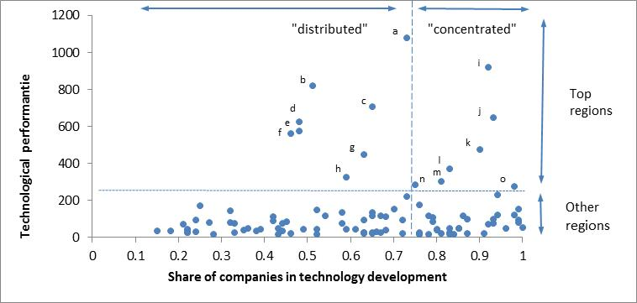
Leading Biotech Regions
The technological performance of regions and the share of biotech technology development activities undertaken by private firms (period 1992-1997)
 | Region, country | patents 1992-97
a | North California, US | 1,083
b | Massachusetts, US | 824
c | South California, US | 711
d | New York, US | 626
e | Maryland, US | 576
f | Île-de-France, FR | 563
g | Pennsylvania, US | 449
h | Inner London, UK | 328
I | Tokyo-TO, JP | 921
j | New Jersey, US | 650
k | Osaka-FU, JP | 477
l | Denmark, DK | 376
m | Illinois, US | 305
n | Karlsruhe, DE | 288
0 | Nordwestschweiz, CH | 280

Slide 18
Leading organisations per regions (period 1992 - 1997)
 | Organisation name | Organisation type
1. North California, US | Genentech Inc. Incyte University of California | New Dedicated Biotech Firm New Dedicated Biotech Firm University
2. Tokyo-TO, Japan | Ajinomoto Co., Inc. Kyowa Hakko Kogyo Co., Ltd. | Established Pharmaceutical Firm Established Firm
3. Massachusetts, US | General Hospital Coporation Genetics Institute | Hospital New Dedicated Biotech Firm
4. South California, US | Amgen Gen-Probe Incorporated Scripps Research Institute | New Dedicated Biotech Firm New Dedicated Biotech Firm Research Center
5. New Jersey, US | Becton Dickinson & Co. Merck | Established Pharmaceutical Firm Established Pharmaceutical Firm
6. New York, US | Bristol Myers Squibb Co. Johnson & Johnson Ludwig Institute for Cancer Research New York University | Established Pharmaceutical Firm Established Pharmaceutical Firm Research Center University
7. Maryland, US | Department of Health and Human Services Human Genome Sciences, Inc. | Research Center New Dedicated Biotech Firm
8. Île de France, France | Institut National de la Sante et de la Recherche Medicale (INSERM) Institut Pasteur Rhone-Poulenc AG | Research Center Research Center Established Firm
9. Osaka-FU, Japan | Ono Pharmaceutical Co., Ltd. Sumitomo Electric Industries, Ltd. Suntory Limited Takeda Chemical Industries, Ltd. | Established Pharmaceutical Firm Established Firm Established Firm Established Firm
10. Pennsylvania, US | BAYER AG Smithkline Beecham University of Pennsylvania | Established Firm Established Pharmaceutical Firm University
11. Denmark | Novo Group | Established Pharmaceutical Firm
12. Inner London, UK | Cancer Research Campaign Technology Limited Medical Research Council Unilever Zeneca | Other Firm Research Center Established Firm Established Pharmaceutical Firm
13. Illinois, US | Abbott Laboratories | Established Pharmaceutical Firm
14. Karlsruhe, Germany | Roche Diagnostics | Established Pharmaceutical Firm
15. Nordwestschweiz, Switzerland | F. Hoffmann-La Roche AG Novartis | Established Pharmaceutical Firm Established Pharmaceutical Firm

Slide 19
What differentiates leading regions?
Correlation table (period 1992-97, panel)
 |  | 1 | 2 | 3 | 4 | 5 | 6 | 7 | 8
1 | Top15 region in 1992-97(per year) | 1
2 | Science-intensity of the region | 0.2531 | 1
3 | Number of firms | 0.7074 | 0.1819 | 1
4 | Company concentration index | -0.3035 | -0.1462 | -0.4633 | 1
5 | Entrepreneurial orientation of knowledge institutes | 0.2956 | 0.1102 | 0.2491 | -0.1686 | 1
6 | International collaboration with knowledge institutes | 0.3804 | 0.0859 | 0.3036 | -0.0976 | 0.0288 | 1
7 | International collaboration with firms | 0.3627 | 0.1557 | 0.4198 | -0.1519 | 0.0625 | 0.2768 | 1
8 | Top15 region in 1978-90 | 0.8173 | 0.156 | 0.6821 | -0.3204 | 0.2806 | 0.3181 | 0.3564 | 1
The top 15 of leading regions is quite stable over time: most of the regions leading in the growth phase of biotech were already among the leading regions in the early phase of biotech.

Slide 20
“Distributed” versus “Concentrated” regions
 | Top “distributed’ regions (n=8) | Top “concentrated” regions (n=7) | z-test
Share of company patents | 0,58 | 0,89 | -7,833 | ***
Number of firms | 23,7 | 20,3 | 2,368 | **
Company concentration index | 0,28 | 0,42 | -2,387 | **
Science-intensity of the region | 0,31 | 0,24 | 2,564 | **
Entrepreneurial orientation of knowledge institutes | 0,014 | 0,004 | 7,177 | ***
International collaboration with knowledge institutes | 0,65 | 1,38 | -1,936 | *
International collaboration with firms | 0,88 | 0,95 | -0,585

Slide 21
What differentiates leading regions?
Random effect logit models (period 1992-97, panel)
Dependent variable: top 15 region in year t (dummy)
P(y_{it} = 1 / x_{it})
with t = 1-6,
x_{it} contains the explanatory and the control variables

Slide 22
Logit models
Dependent: Top 15 region in year t | All Regions | Regions with distributed texture | Regions with concentrated texture
Science-intensity of the region | 17.56** (7.89) | 86.18*** (25.07) | 52.39*** (17.34)
Number of firms | 0.69*** (0.18) | 2.17** (0.87) | 0.92** (0.41)
Company concentration index | 6.14** (3.02) | -22.77 (23.41) | 25.34*** (9.56)
Entrepreneurial orientation of knowledge institutes | 201.14** (102.21) | 1479.37*** (557.68) | 504.07 (329.23)
International collaboration with knowledge institutes | 1.28** (0.60) | 3.36 (5.24) | 4.32*** (1.25)
International collaboration with firms | -0.41 (0.57) | -1.98 (3.08) | -0.31 (0.99)
Population | 0.0005 (0.0003) | 0.0007 (0.0006) | 0.0032*** (0.0012)
US dummy | -0.23 (1.96) | 14.24* (7.57) | -6.07 (6.38)
Time | -0.78*** (0.29) | -0.87 (1.16) | -2.52*** (0.76)
Constant | -19.06*** (5.03) | -75.49*** (18.35) | -51.66*** (10.34)
Observations | 606 | 384 | 222
Loglikelihood | -525.07 | -9.86 | -27.23
P | 0.0086 | 0.0021 | 0.0004

Slide 23
Logit models
Dependent: 50+ patents in year t | All Regions | Regions with distributed texture | Regions with concentrated texture
Science-intensity of the region | 15.9878** | 128.8433** | 13.6843**
 | (7.2120) | (53.0681) | (5.6512)
Number of firms | 1.0939*** | 3.9204*** | 0.7663***
 | (0.3456) | (1.3448) | (0.2666)
Company concentration index | 12.6620*** | 37.0340 | 13.0538***
 | (4.5808) | (23.8473) | (3.8692)
Entrepreneurial orientation of knowledge institutes | 208.1506* | 2656.7882** | 151.3680
 | (107.8376) | (1073.5096) | (135.8551)
International collaboration with knowledge institutes | 0.8308 | 1.0994 | 0.8270**
 | (0.5248) | (8.7883) | (0.3998)
International collaboration with firms | -0.3691 | 3.2534 | 0.1325
 | (0.5992) | (4.0294) | (0.4224)
Population | 0.0004 | 0.0026** | 0.0007*
 | (0.0003) | (0.0010) | (0.0004)
US dummy | 0.1496 | 22.1975* | -2.8928
 | (1.8077) | (13.3692) | (2.5272)
Time | 0.2306 | 0.6233 | 0.0912
 | (0.3564) | (1.4026) | (0.3043)
Constant | -28.2073*** | -165.3706*** | -23.1624***
 | (9.1306) | (58.1167) | (5.4902)
Observations | 606 | 384 | 222
Loglikelihood | -36.4927 | -8.3607 | -17.4629
p | 0.0749 | 0.1613 | 0.0083

Slide 24
Conclusions
Based on a systematic, quantitative analysis of texture characteristics of 101 biotech regions worldwide for the period 1992-1997, we find evidence for:
the existence of 2 types of regions with different texture characteristics: distributed and concentrated regions.
Both type of regions can become a leading region: regional technology development activities do not need to be primarily driven by private firms.
Leading regions build on a strong science base and are characterised by the presence of growing industrial activities in the field of biotechnology
Concentrated regions benefit from the concentration of biotech activities within an leading, “anchor-tenant” firm.
Distributed regions benefit from the entrepreneurial orientation of their knowledge institutes.

Slide 25
Limitations and further research
Focusing on the specific nature of each type of actor might yield complementary insights into ‘recipes’ for growth within science-intensive technological fields (e.g. the respective roles of universities and more focused (public) research institutes; unraveling the relationship between the presence of large, established (pharmaceuticals or chemicals) firms versus smaller dedicated biotech ventures, the concentration of the industrial texture and the presence of related technologies in the region).
Further refining of the results, taking into account the extent to which regions are specializing in one or more specific niches in biotech or alternatively, developing a wide range of biotech activities, and investigate how different levels of specialization are related to cluster development.

Slide 26
Thank you!
Contact: bart.vanlooy@kuleuven.be

